Slide 1
Digital Portfolio
STUDENT NAME: R.HEMAVATHI
REGISTER NO AND NMID: astvu36336324u18017
DEPARTMENT: B.SC COMPUTER SCIENCE
COLLEGE: COLLEGE/ UNIVERSITY: ABIRAAMI ARTS AND SCIENCE COLLEGE FOR WOMENS/THIRUVALLUVAR UNIVERSITY

Slide 2
PROJECT TITLE
DIGITAL PORTFOLIO FRONT END DEVELOPMENT

Slide 3


AGENDA
Problem Statement
Project Overview
End Users
Tools and Technologies
Portfolio design and Layout
Features and Functionality
Results and Screenshots
Conclusion
Github Link
3/21/2024 Annual Review

Slide 4

PROBLEM STATEMENT
Problem Statement
Students need an effective way to showcase their skills, achievements, and personal growth.
Traditional paper portfolios limit creativity, accessibility, and interactivity.
A digital solution is needed for easier updates and multimedia integration.
Many students lack experience with digital tools for organizing their work.
This project addresses these issues by creating a personalized digital portfolio.

Slide 5

PROJECT OVERVIEW
Project Overview
This project involves designing and developing a personalized digital portfolio.
The portfolio showcases academic work, skills, achievements, and personal growth.
It is created using digital tools to ensure a professional and creative layout.
The goal is to enhance digital literacy and self-presentation skills.
The final product is accessible, easy to update, and ready for academic or career use.

Slide 6

WHO ARE THE END USERS?
Students – to showcase their academic work, skills, and personal growth.
Teachers and Educators – to assess student progress and provide feedback.
Employers – to evaluate candidates’ skills and projects during job applications.
College/University Admission Officers – to review applicants’ achievements and creativity.
Peers and Mentors – to view, share, and collaborate on learning and development.

Slide 7

TOOLS AND TECHNIQUES
Digital Portfolio Tools and Techniques
Website Builders – Tools like Google Sites, WordPress, or web for creating and publishing portfolios online.
Design Tools – Canva, Adobe Spark, or Figma for creating visually appealing graphics, layouts, and presentations.
Document and File Management – Google Drive, Microsoft OneDrive, or Dropbox for organizing and storing project files.
Multimedia Integration – Embedding videos, images, audio, and presentations to make the portfolio interactive and engaging.
Navigation & Layout Techniques – Using clear menus, consistent themes, and user-friendly design to ensure easy access and professional presentation.

Slide 8
POTFOLIO DESIGN AND LAYOUT
Design and Layout
The portfolio uses a clean, user-friendly layout with easy navigation.
Consistent fonts, colors, and themes are applied for a professional look.
Sections are clearly divided (e.g., About Me, Projects, Skills, Contact).
Visual elements like images, icons, and videos enhance engagement.
Responsive design ensures the portfolio looks good on all devices.
8

Slide 9
FEATURES AND FUNCTIONALITY
Features and Functionality
Includes sections like About Me, Projects, Skills, Certificates, and Contact.
Supports multimedia content such as images, videos, and PDFs.
Easy-to-navigate interface with clickable menus and internal links.
Responsive design for compatibility across devices (mobile, tablet, desktop).
Editable and updatable anytime to reflect new achievements and skills.

Slide 10
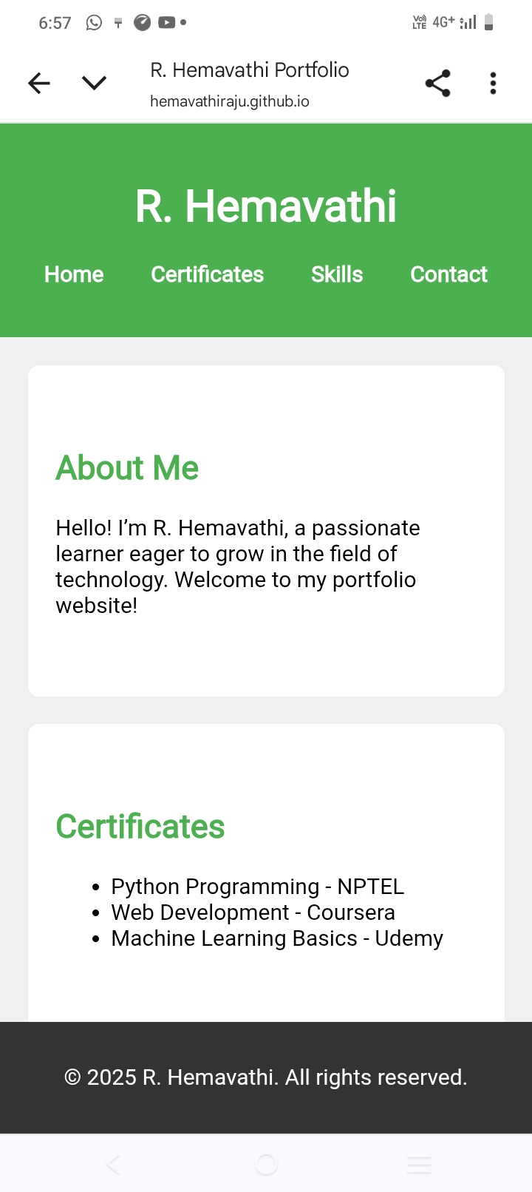

RESULTS AND SCREENSHOTS
3/21/2024 Annual Review
10

Slide 11
CONCLUSION
•Creating this digital portfolio has enhanced my skills in design, organization, and digital communication. •It allowed me to reflect on my academic and personal growth in a creative and structured way. •using digital tools helped me present my achievements more effectively and professionally. •The experience improved my confidence in using technology for self-presentation. Overall, the portfolio serves as a valuable tool for future academic and career opportunities.
11

Slide 12
GitHub link:https://hemavathiraju.github.io/hemarportfolio/

